Slide 1

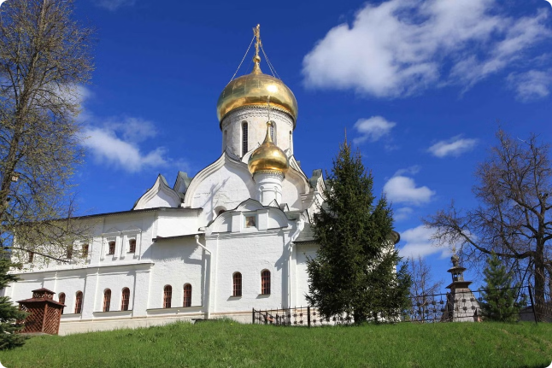

Alcoholic Drinks in Russia
Explore the rich history and diverse landscape of Russian alcoholic drinks.
by justin raj

Slide 2

Vodka: The National Spirit
1
History
2
Production
Distilled from grain, potatoes, or beets.
Strict regulations ensure high quality.
3
Culture
4
Varieties
Integral part of Russian traditions.
From classic to flavored vodkas.

Slide 3

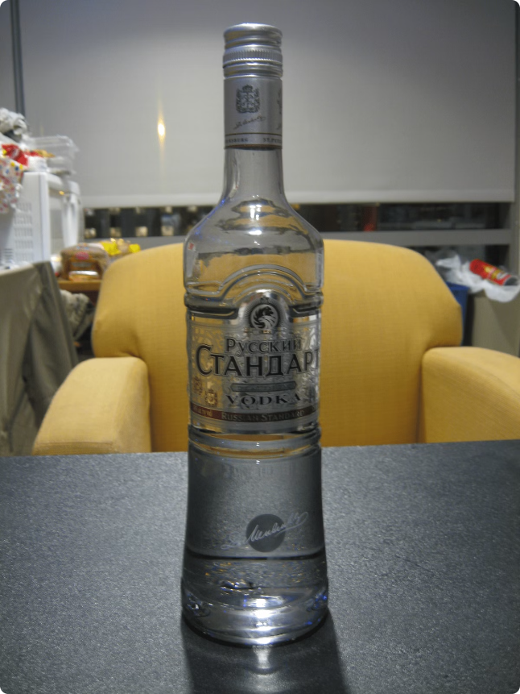
Traditional Russian Liqueurs
Liqueurs
History
Made with herbs, fruits, and spices.
Long tradition of using liqueurs in Russian cuisine.
Flavors
Uses
From sweet and floral to herbal and bitter.
Enjoyed on their own or in cocktails.

Slide 4





Trends in Russian Cocktail Culture
Modern Mixology
Focus on fresh ingredients and techniques.
Local Spirits
Using vodka, liqueurs, and craft beers in cocktails.
International Influences
Fusion of classic and contemporary styles.
Experiential Dining
Innovative bars and restaurants.

Slide 5

Design Considerations for Promotional Materials
Target Audience
Demographic and psychographic characteristics
Brand Identity
Visual representation of the brand
Messaging
Clear and compelling communication
Channels
Digital and print media

Slide 6

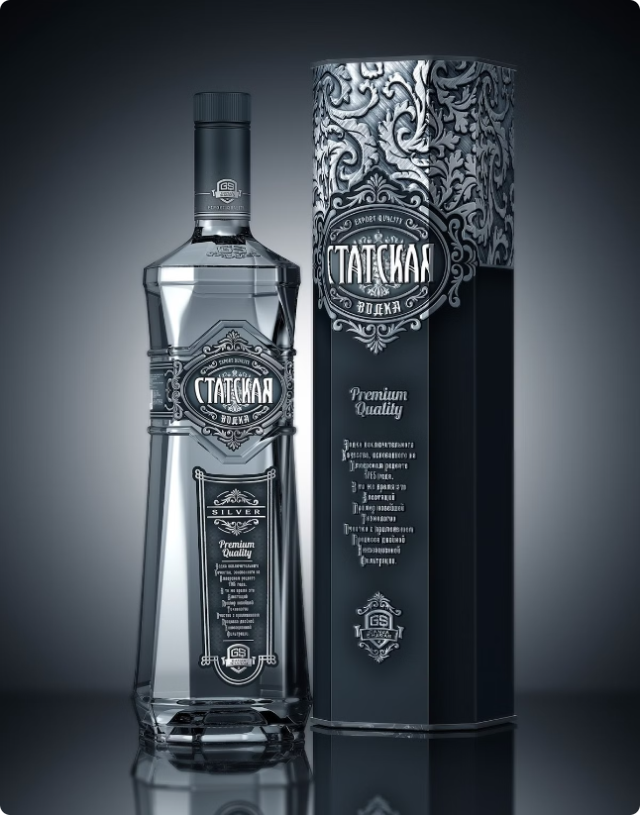




Branding and Packaging Strategies
Premium Packaging
Russian Heritage
High-quality materials and design.
Embracing traditional motifs and aesthetics.
Modern Trends
Brand Storytelling
Incorporating contemporary design elements.
Communicating the brand's history and values.

Slide 7


Conclusion and Next Steps
Continued innovation and exploration of Russian alcoholic drinks.
I have used bar plots and box plots
promoting the brands to sale lower cost. for example: beer has mostly sales in India while summertime. Just Rs:150 to 190.
The Russian mostly uses drinks while party and dinner taken as wine and beer mostly.
The vodka demand has increased up till 2002 and it's declining slowly and steadily with time.
up to my point of view is alcoholic price changes the brand has unique value form 2002 till 2016.
mainly the explore the brand value might be highest or lowest price.
The retail price range for Russia beer is between US$ 0.61 and US$ 1.15 per kilogram or between US$ 0.28 and US$ 0.52 per pound (lb).
but I prefer drinking is not good for health.

Slide 8
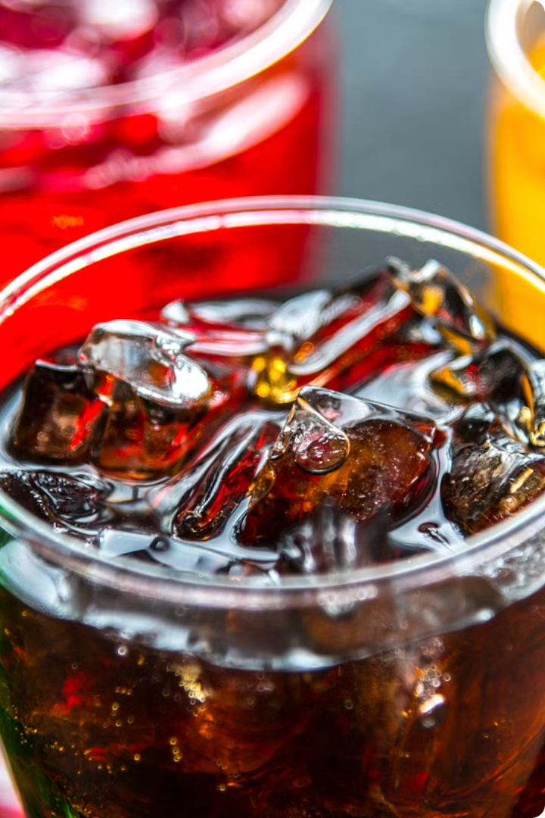
Thank you All for giving me this opportunity to present.
I'm honored to have the chance to share my insights with all of you today. Through this presentation, I hope to provide valuable information that will help us move our business forward in an impactful way.

